Slide 1
SL normalization
Jan 2025

Slide 2
VAMS plates
Plate 2024_014
14 flagged samples (out of 35 VAMS sample in this plate)
Reason: 20_Scale smaller than 0.4
Plate 2024_016
5 flagged samples – 4 are VAMS samples (out of 7 VAMS sample in this plate) the latter is PROphet sample
Reason: 20_Scale smaller than 0.4
Plate 2023_021
7 flagged samples – 4 (2 are not in Coren’s file, ) are VAMS samples (16 VAMS samples in the plate), 1 plasma and - 1 calibrator 1 QC (flagged in previous step, not on ANML)
Reasons: 20_Scale smaller than 0.4, 0_005_Scale larger than 2.5

Slide 3
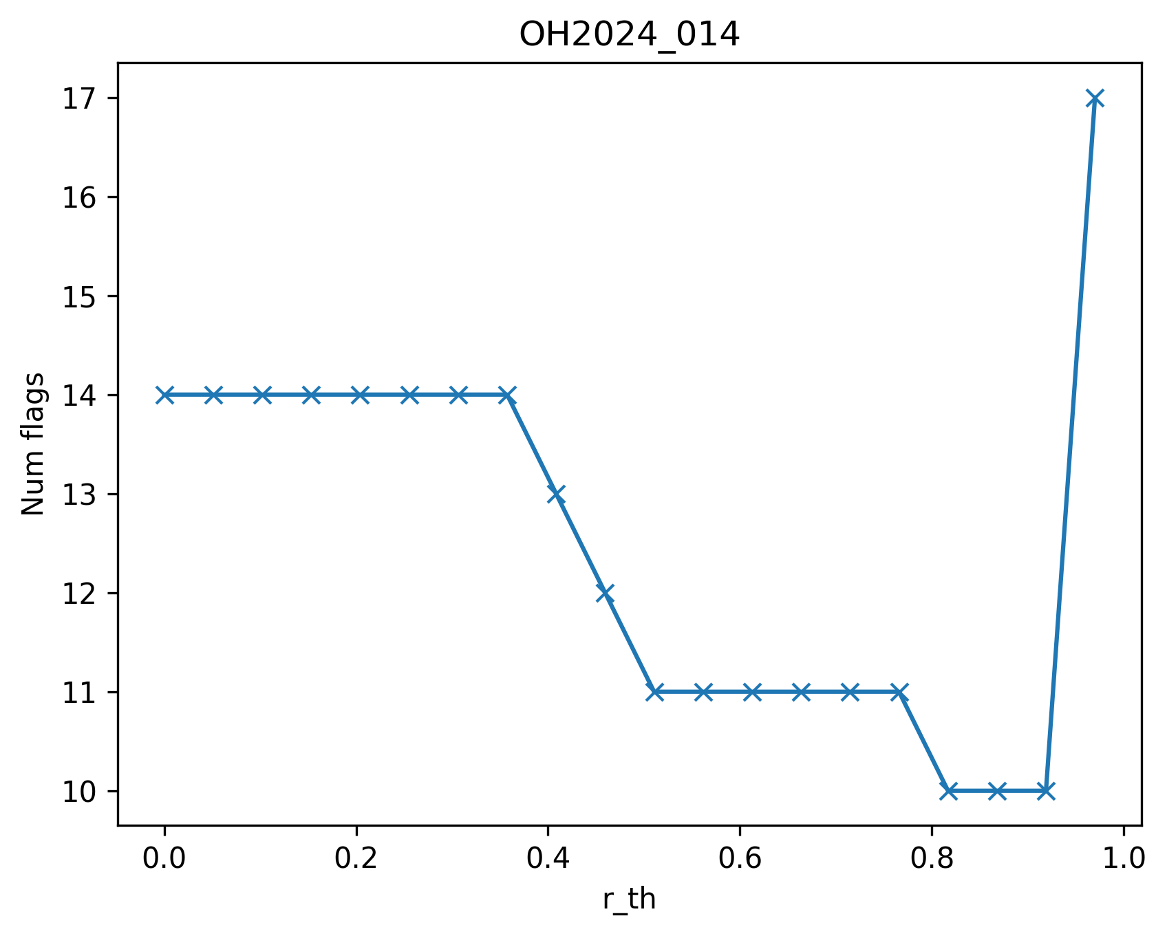
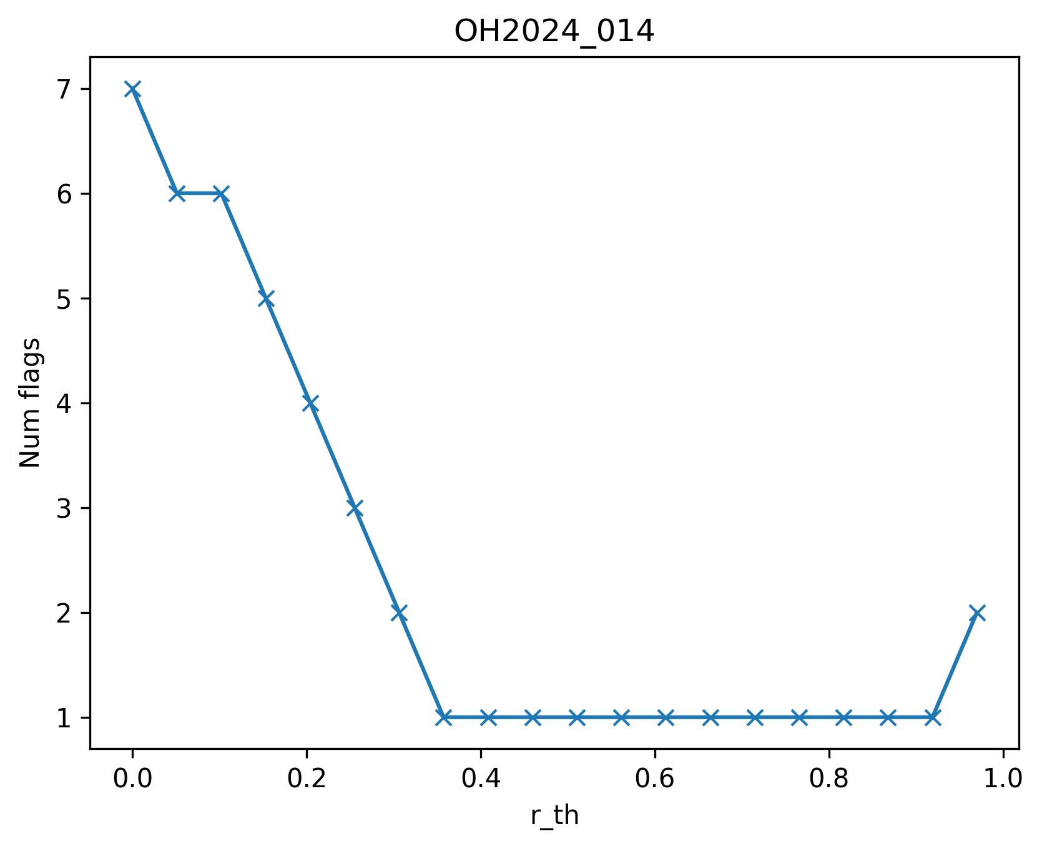
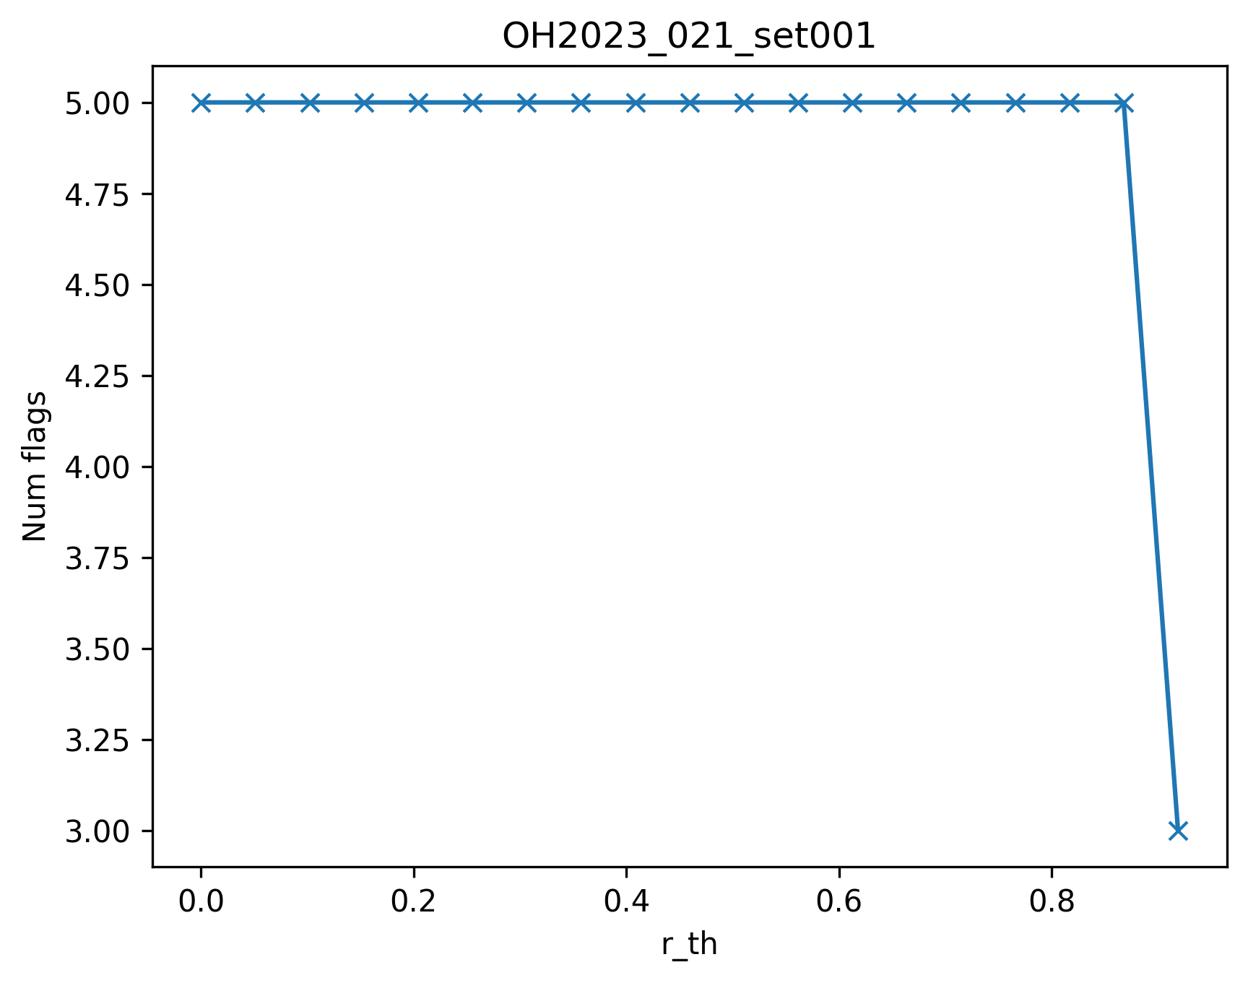
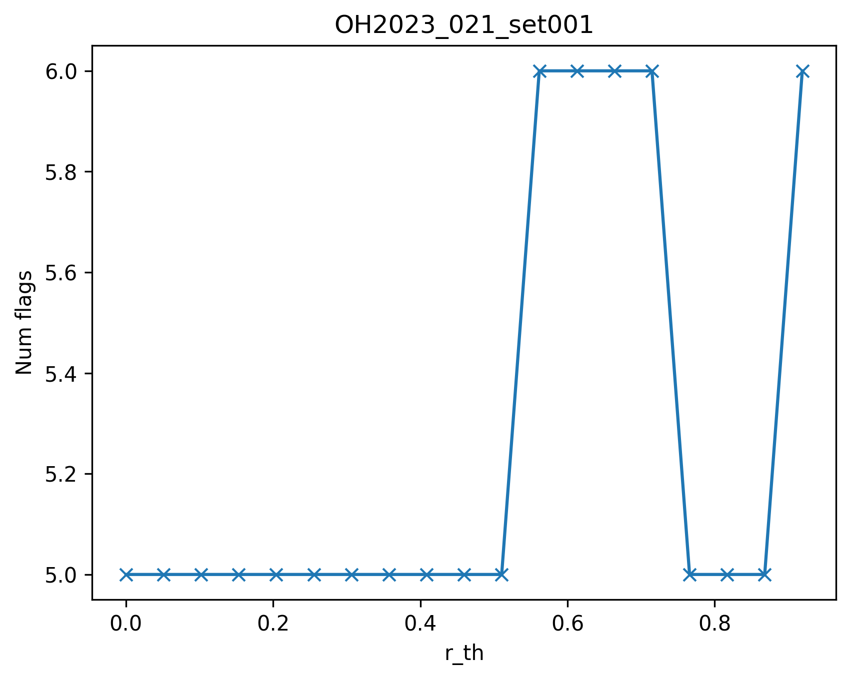
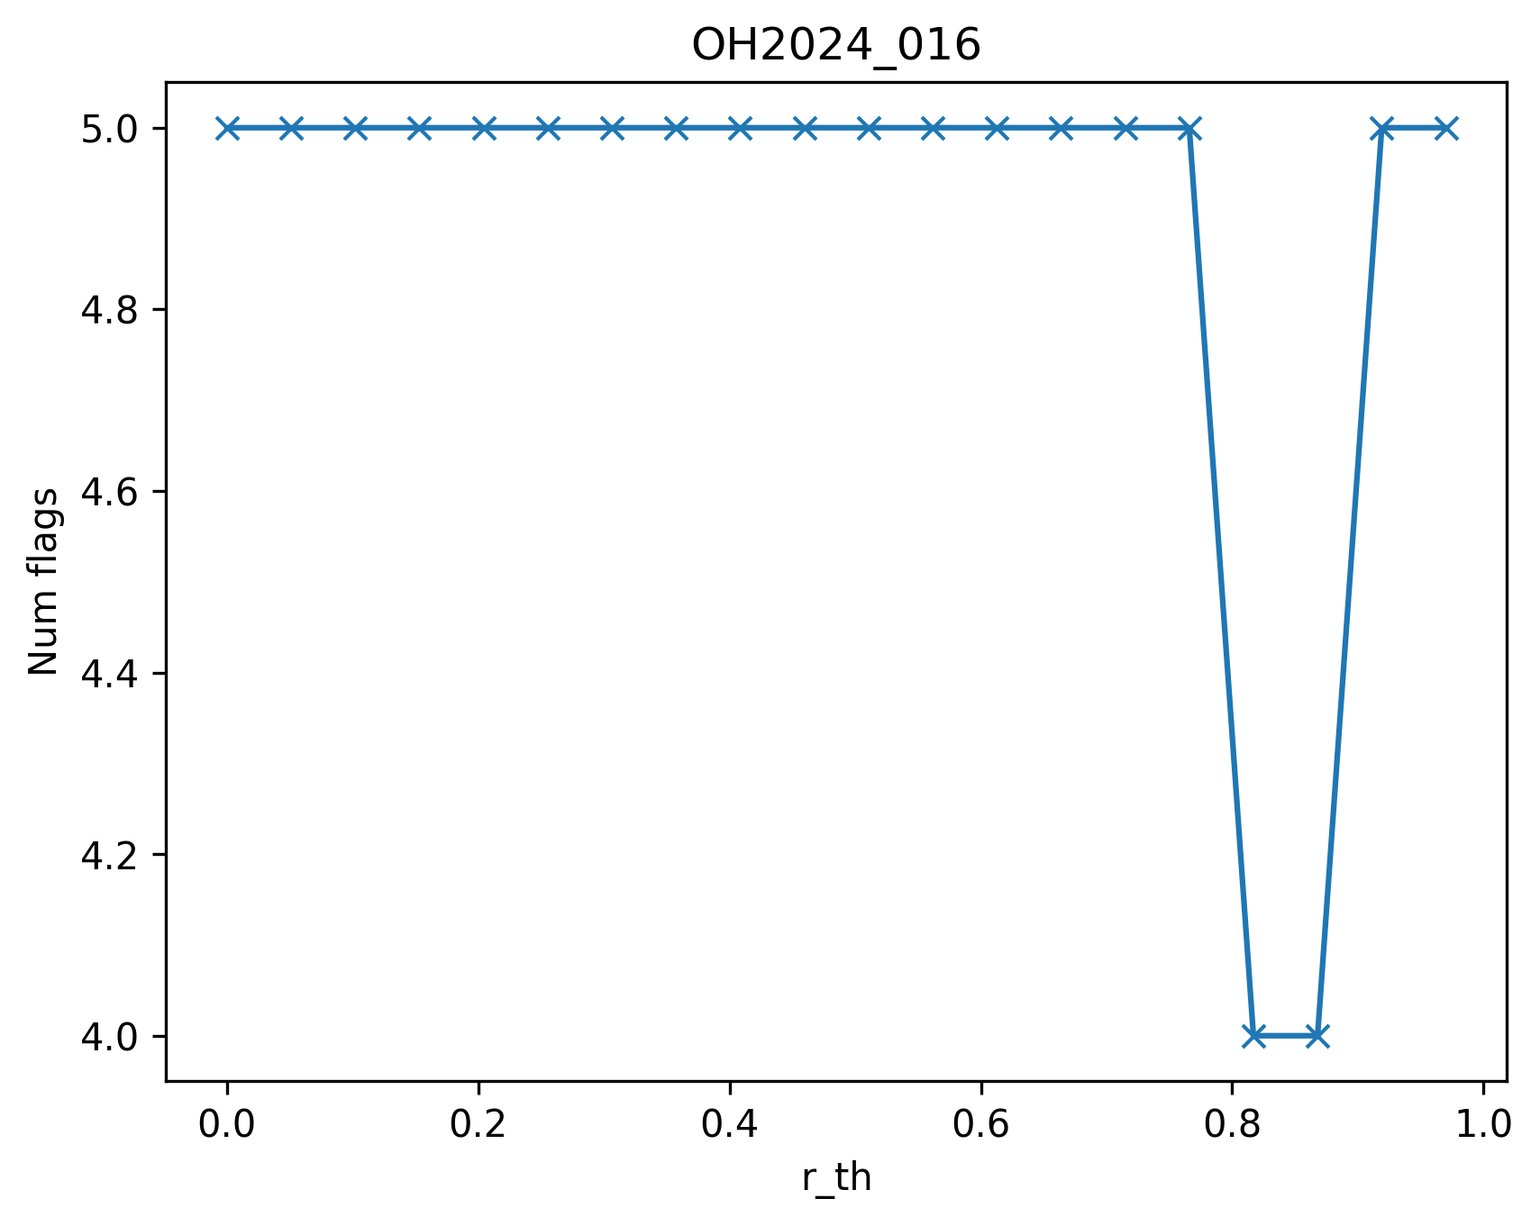
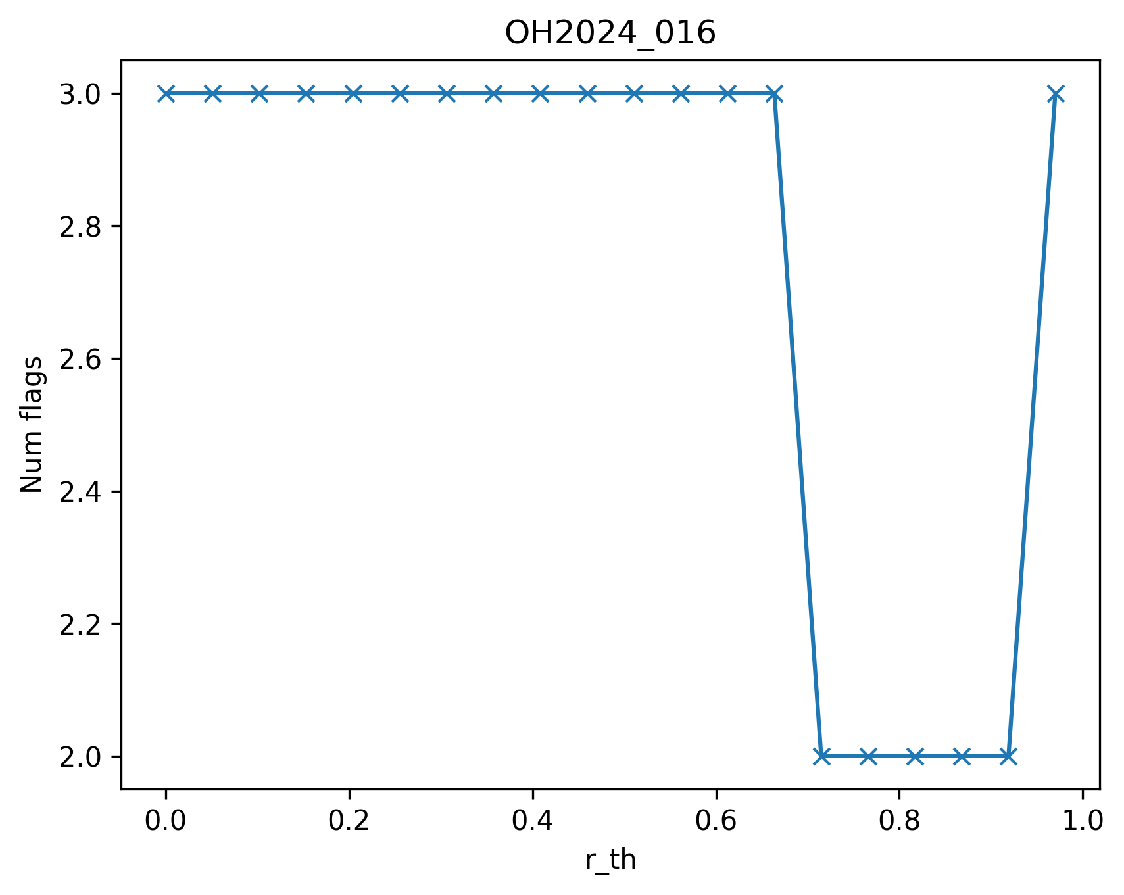
Reducing number of proteins
Filtering using two methods:
Adjusting the correlation threshold to VAMS
Same as 1 + applying Sheba filter
Sheba filter yeilds a higher reduction of flags
1
2
'20_Scale smaller than 0.4’ in all flags in 014, 016
No change in plate 021 too

Slide 4
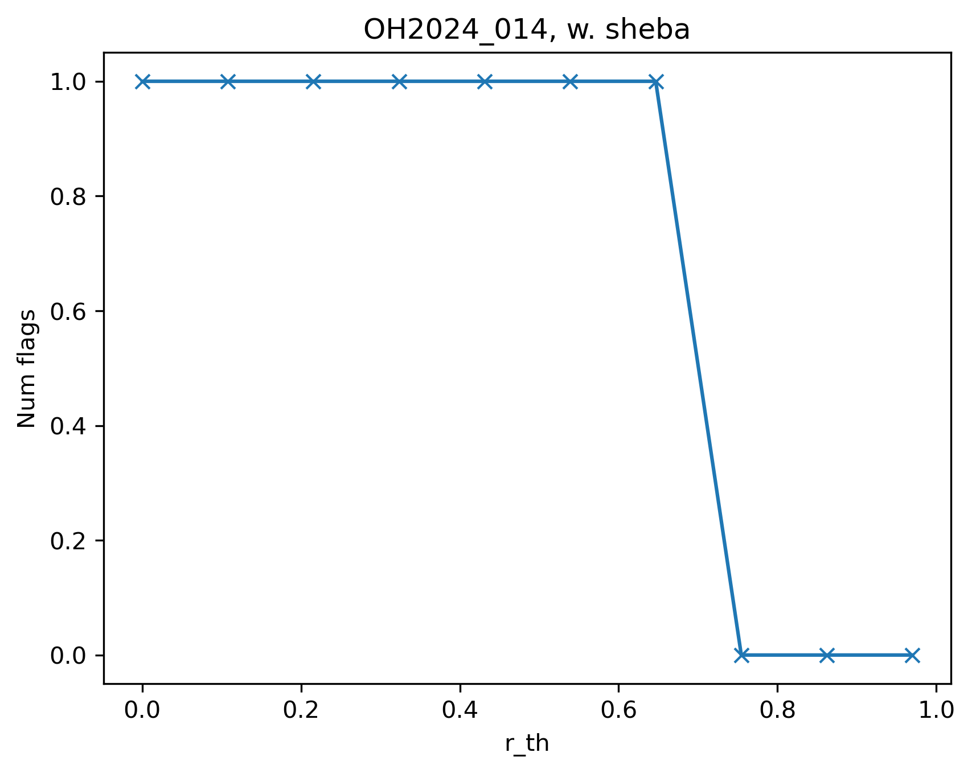
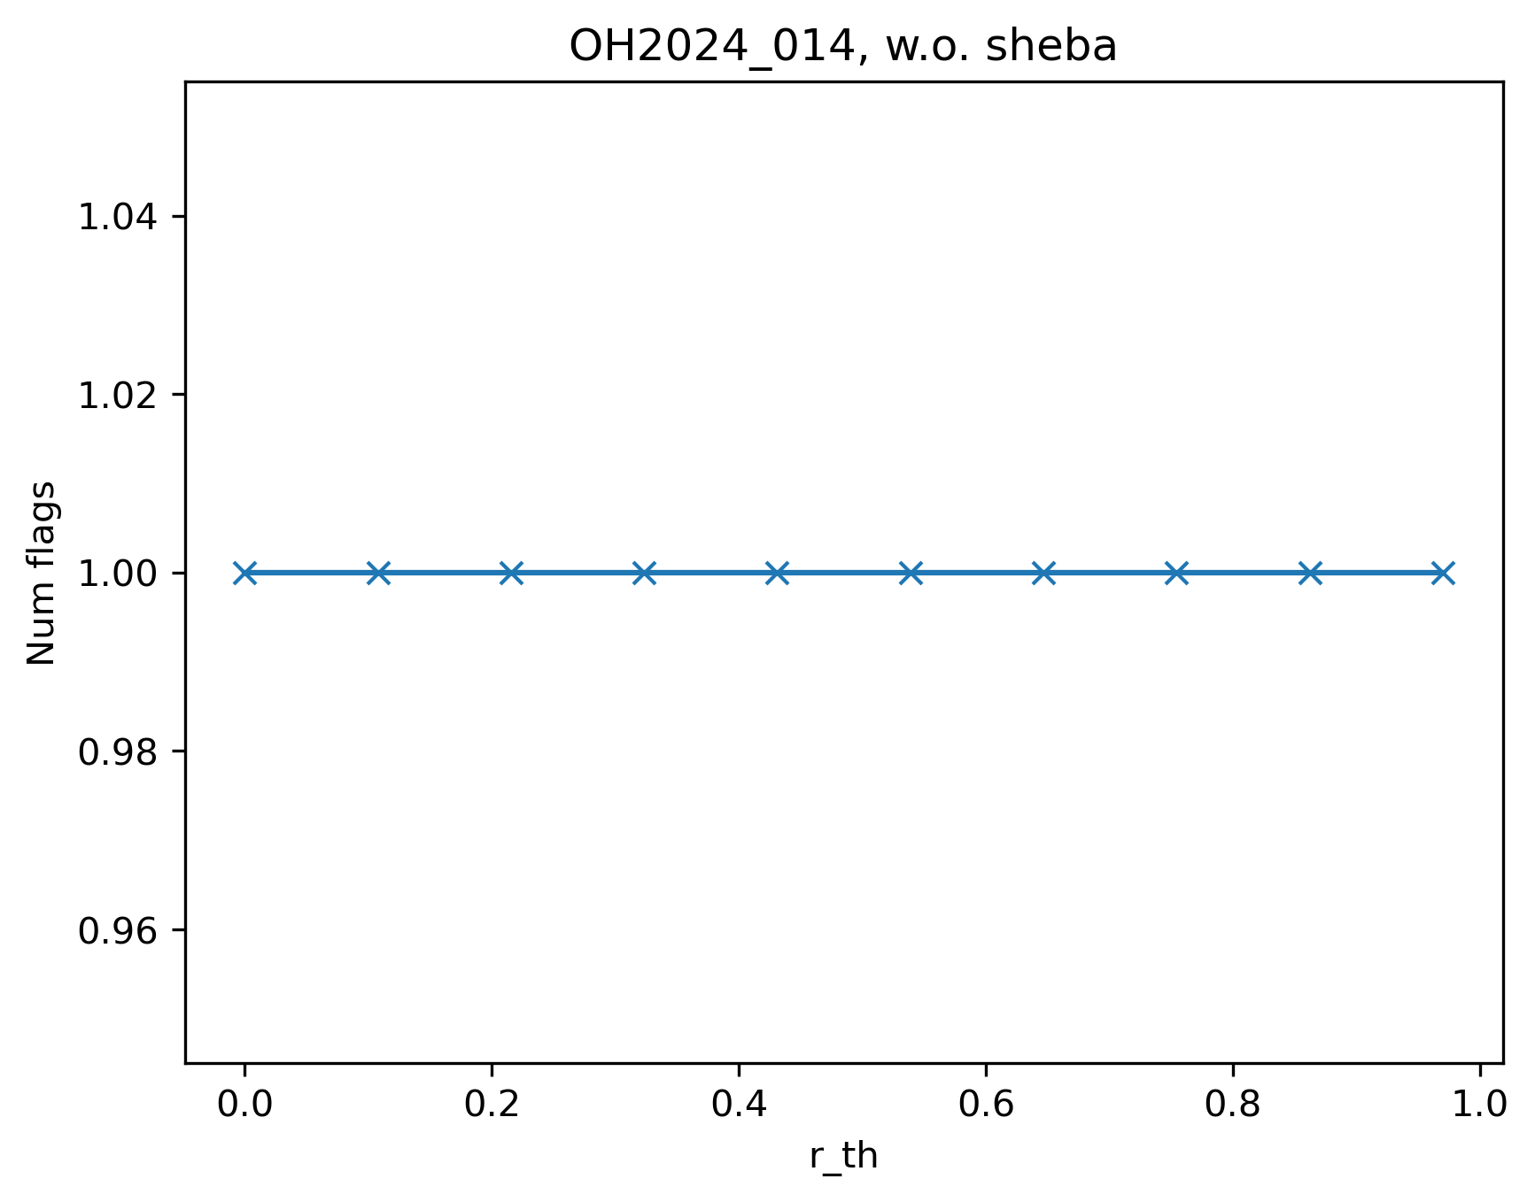
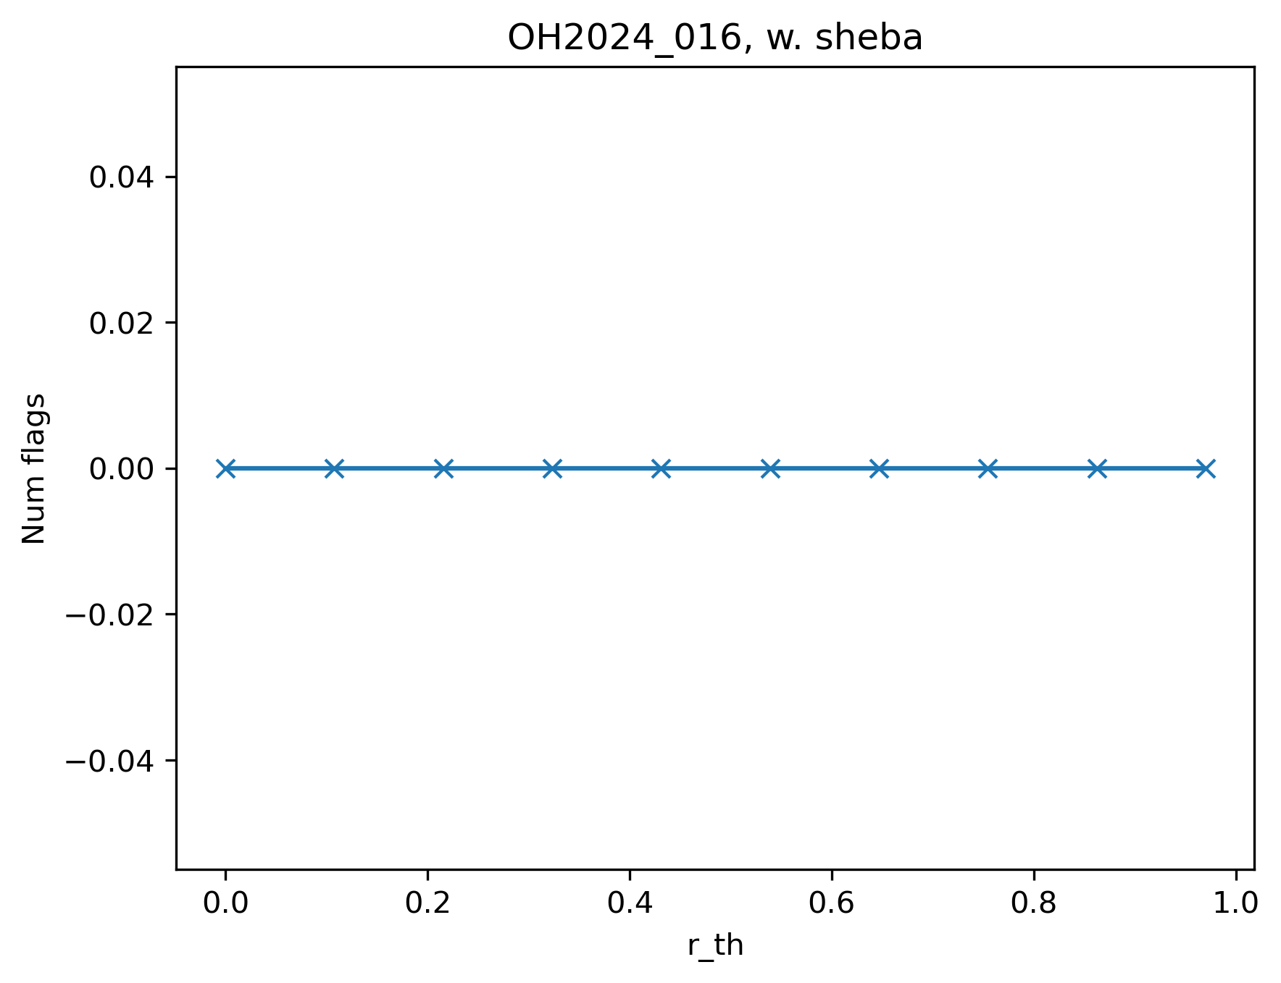

New reference file
Median of calibrate step samples
 | OH2024_014 | OH2024_016 | OH2023_021_set001
ANML flags with SL ref | 14 | 5 | 5
ANML flags with OH ref | 1 | 1 | 5

